Slide 1
Audio Amplifier Project
Supervised by:
DR. Said Emam

Slide 2
Introduction
What is audio amplifier?
The main part is IC LM386.
Input is given through phone.

Slide 3
List of components
NO. | Name | Value
1 | IC | LM386
2 | Ceramic Capacitors | 0.1uf , 47nf
3 | Polar Capacitor | 220uf , 10uf , 100uf
4 | Resistors | 10-ohm , 1.2 ohm
5 | Potentiometer | 10k ohm
6 | Speaker | 8-ohm, 0.5 watt
7 | Battery | 9v
8 | Input Jack

Slide 4
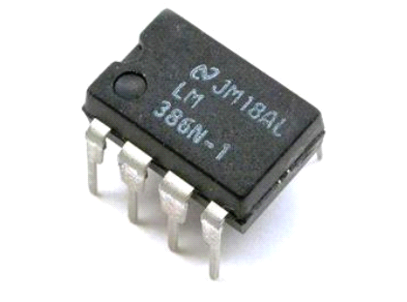
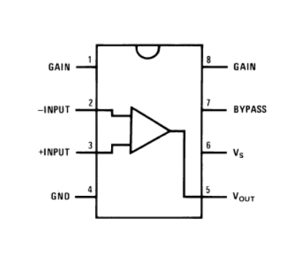
IC LM386
IC LM386 is a low power audio amplifier integrated circuit.
It uses a set of transistors to amplify the sound.
It is an 8 pin IC.
It operates on 9v supply.

Slide 5
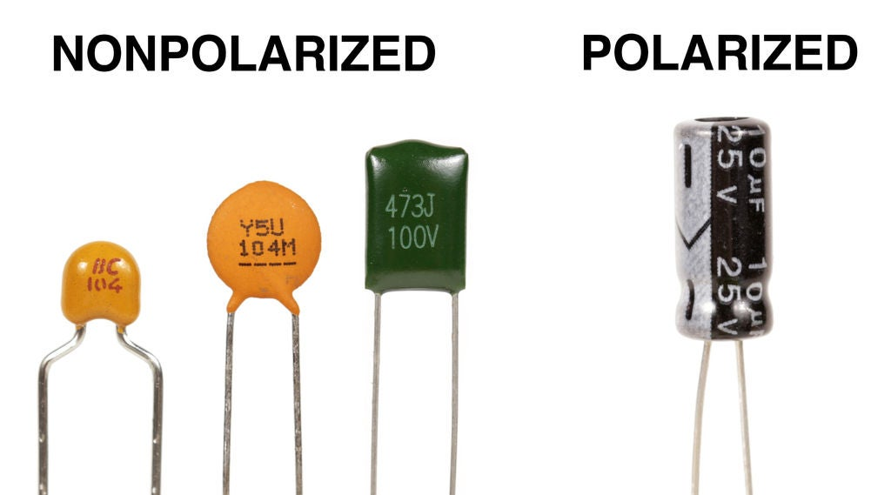
Polar Capacitor
They are used to reduce audio noise to keep a clean audio signal.
An electrolytic capacitor is a type of capacitor that uses an electrolyte to achieve a larger capacitance than other capacitor types.
The voltage on the positive terminal must be greater than the voltage on the negative terminal.

Slide 6
Ceramic Capacitor
Used in:
Temperature compensation.
Coupling and decoupling applications.
Ac power supply applications.
Bypassing applications.

Slide 7
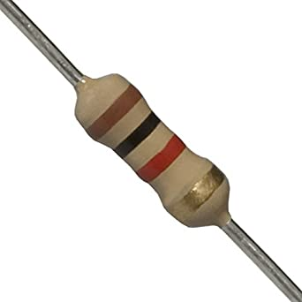
Resistors
There are many types of resistors, both fixed and variable.
The most common type used is the carbon resistor.
It lowers the voltage.
The lower resistance path acts like a magnet that attracts the current to it.

Slide 8
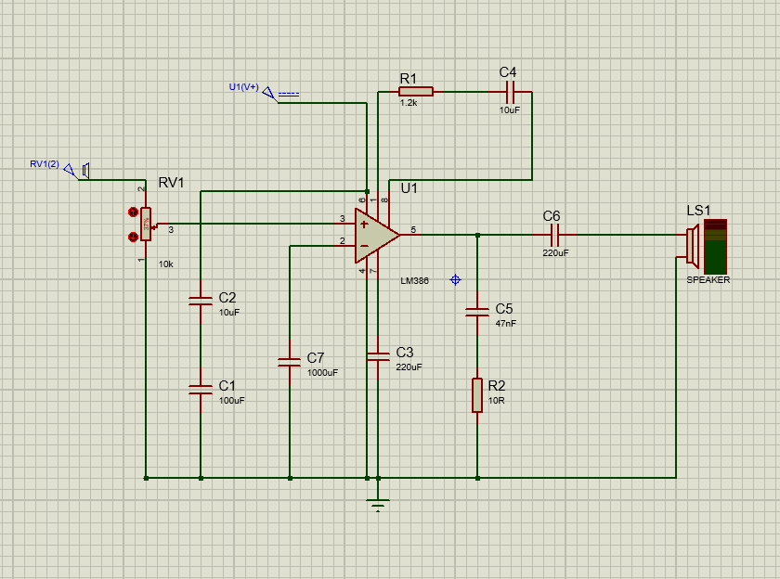
Circuit Diagram

Slide 9
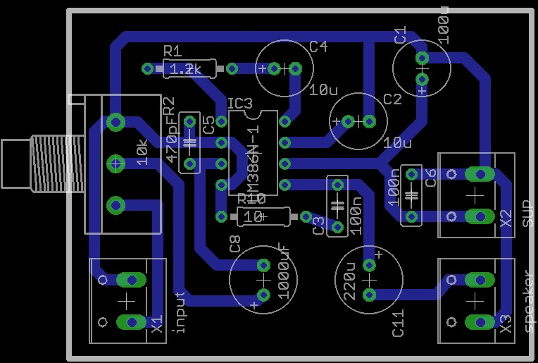
PCB Layout

Slide 10
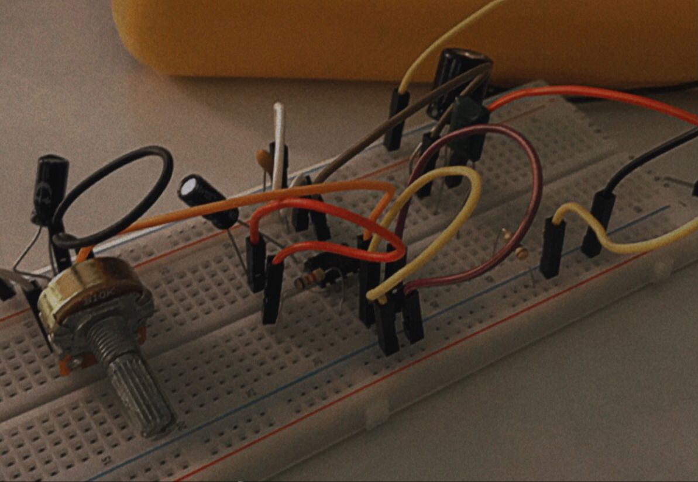
Testing on Breadboard

Slide 11
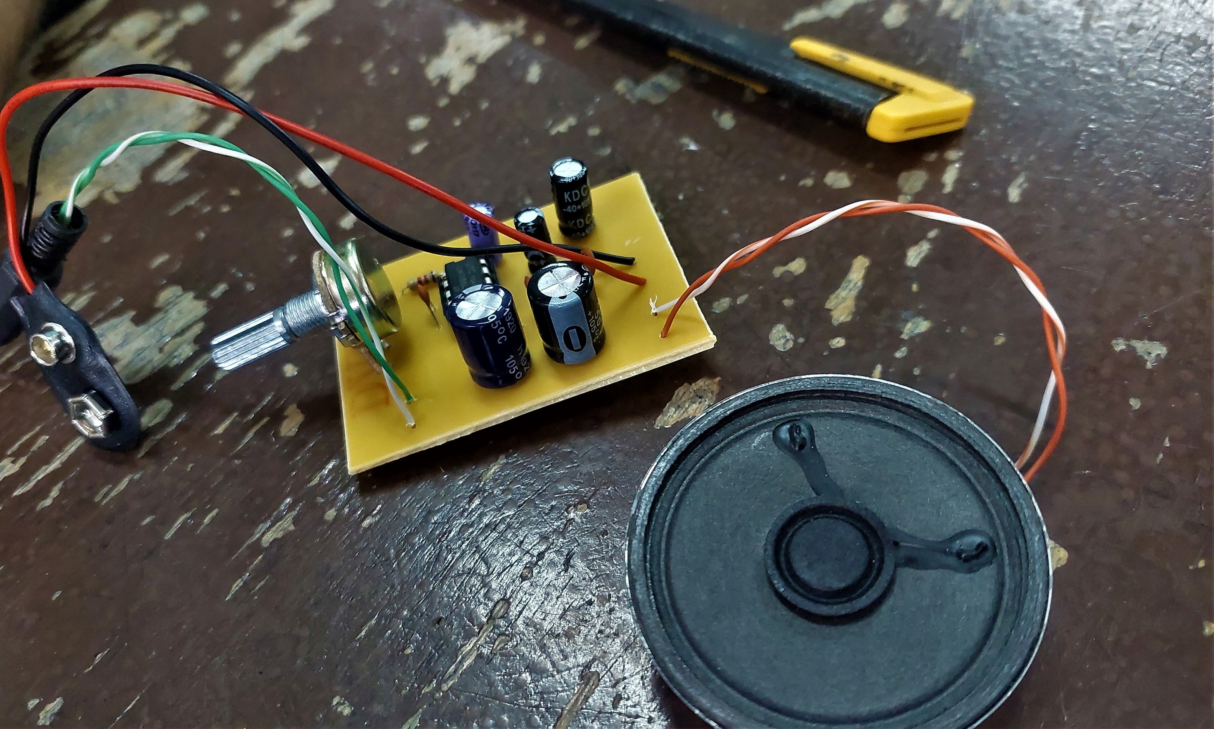
Components of Audio Amplifier

Slide 12
Conclusion
The circuit of this amplifier is not so complex, so it is easy to make it.
This amplifier circuit uses capacitor and resistor and an IC, due to the cost is very low.
The reliability of this audio amplifier is also high.

Slide 13
Meet our team
Malak Mounir
Ahmed Khaled
Nourhan Farag
Youssef Mohamed
Habeba Alaa

Slide 14
Thank you

